Slide 1

Electron Grid of Aligned Documents
Grid based framework for creating native web applications
Advised by Professor Brian Moriarty | Developed by Bailey Sostek

Slide 2
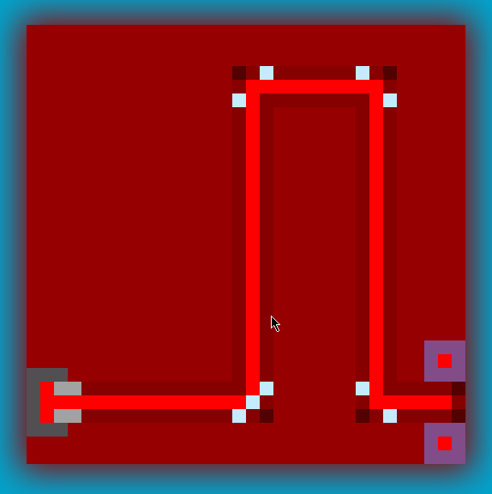


2900
3900
Notes:
Initial idea was to create an IDE for a specific Language
How many people have taken IMGD2900 or 3900? Digital Game Design 1 or 2
What did you use, WebStorm?

Slide 3
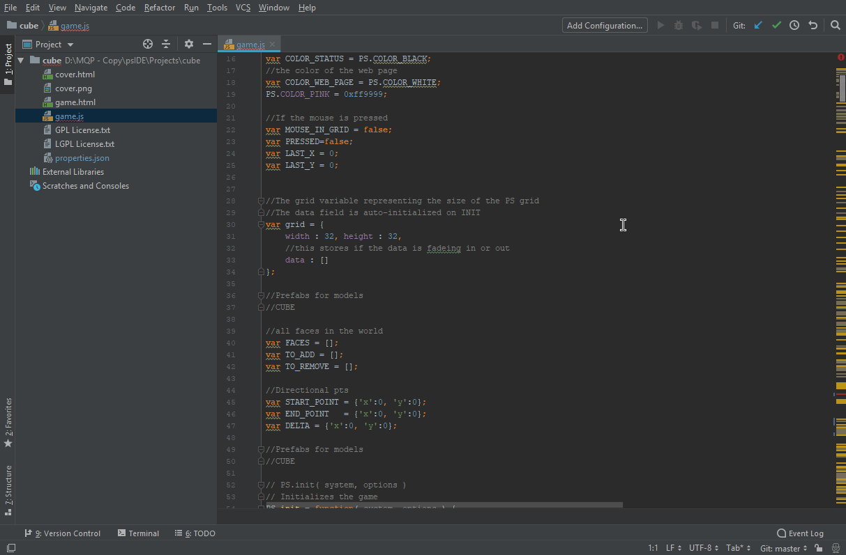

Notes:
Initial idea was to create an IDE for a specific Language
How many people have taken IMGD2900 or 3900? Digital Game Design 1 or 2
What did you use, WebStorm?

Slide 4
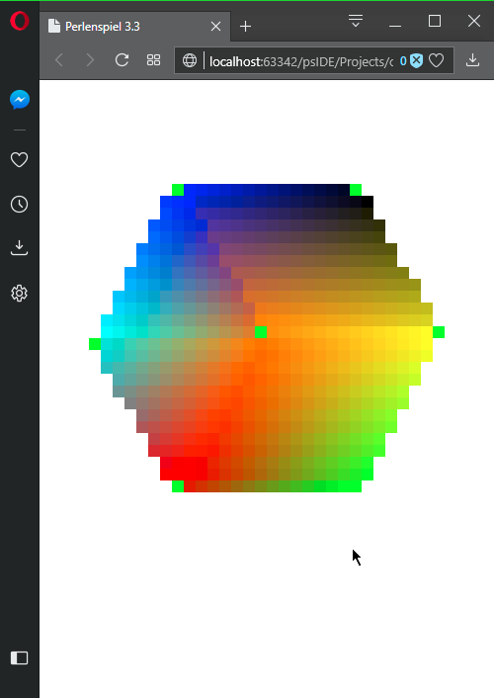
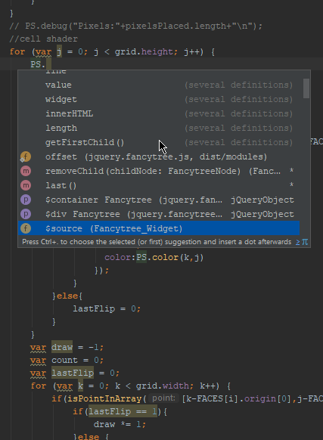
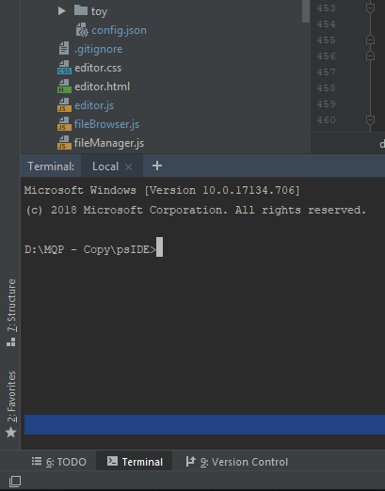
1
2
3
Notes:
Downsides to Webstomr

Slide 5
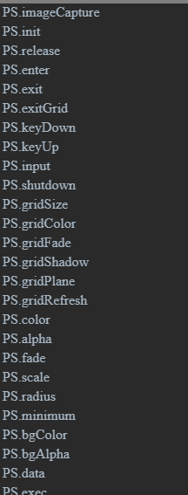
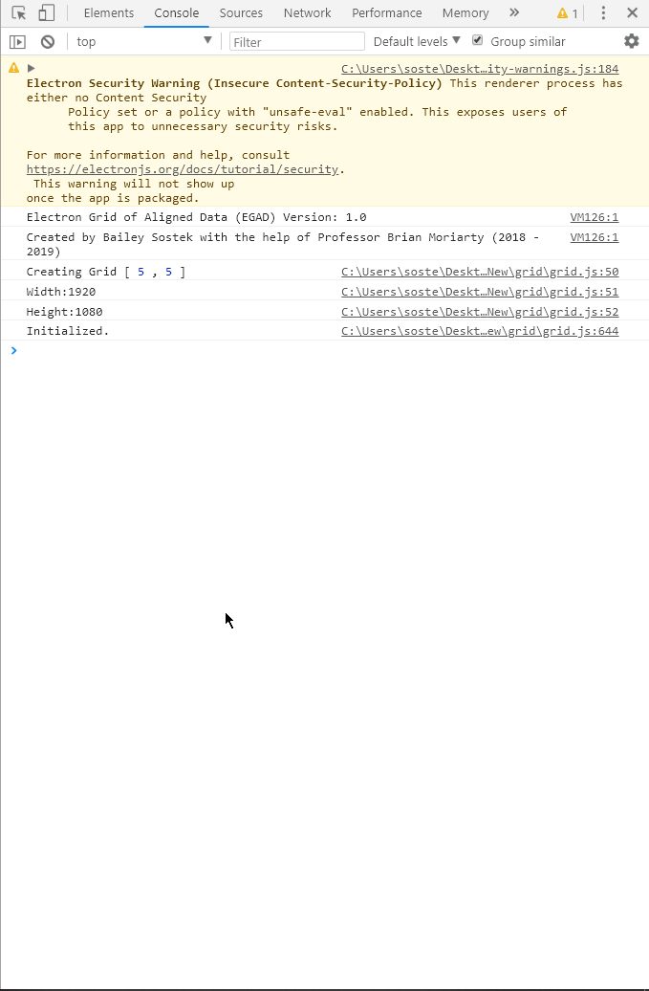
1
2
3
Notes:
Needed to Have access to the V8 Javascript Interpreter running the page -Needed to have knolwege of the Perlenspeil Library Functions, for Intellisence reasons -Live Output

Slide 6
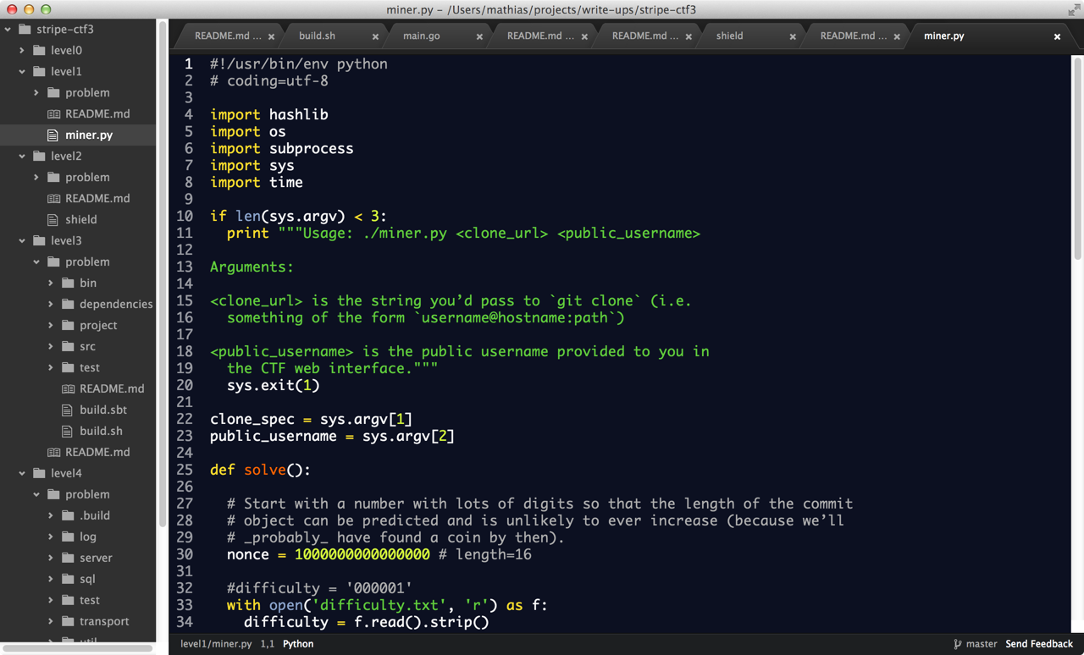
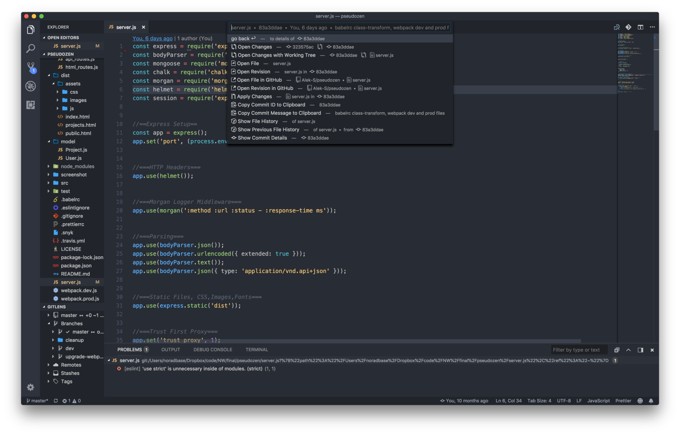


Open Source
Easily Extendable
Notes:
Started to Wonder what was out there

Slide 7



Notes:
Turn Web Pages into Desktop Applications

Slide 8

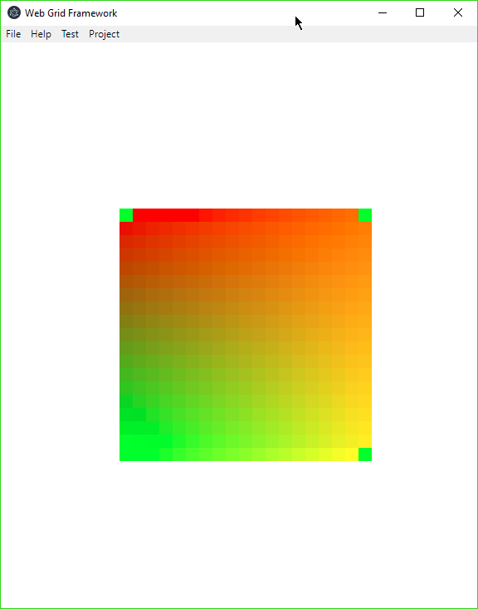
Notes:
Any webpage can be represented as a native application, we could easily create a Perlenspiel Editor, all that was needed was a framework to dock webpages into different regions of the screen much like VSCode or Atom

Slide 10
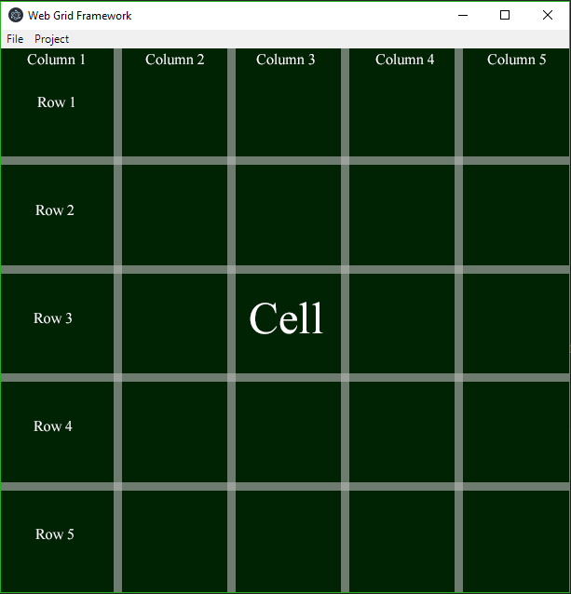
Electron Grid of Aligned Documents
Notes:
Developer can specify a grid size, then fill each cell with a specific piece of content, which would be its own webpage.

Slide 11
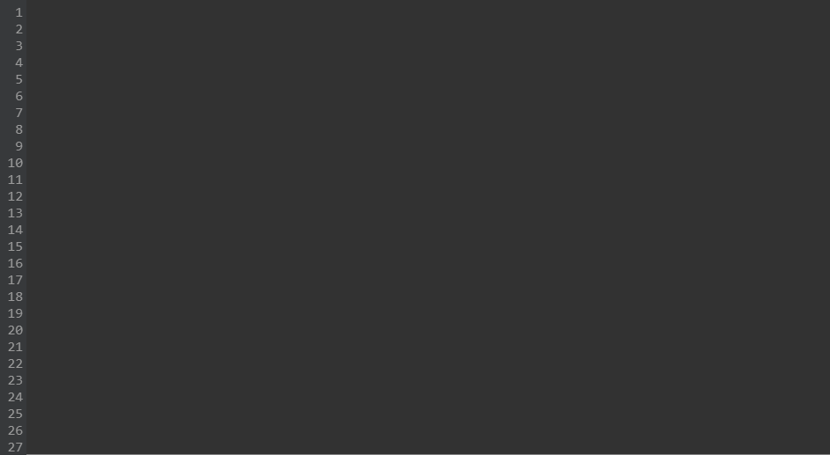
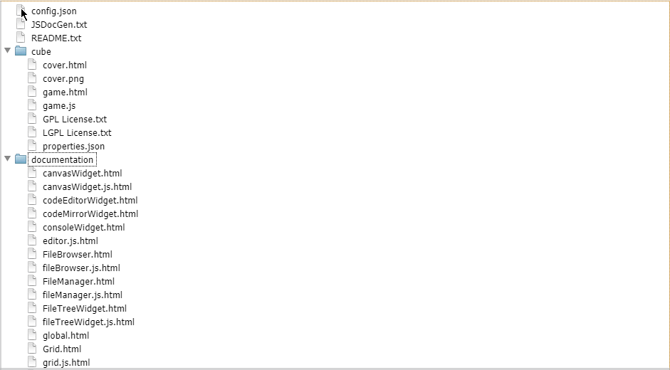
Needed Widgets

Slide 12
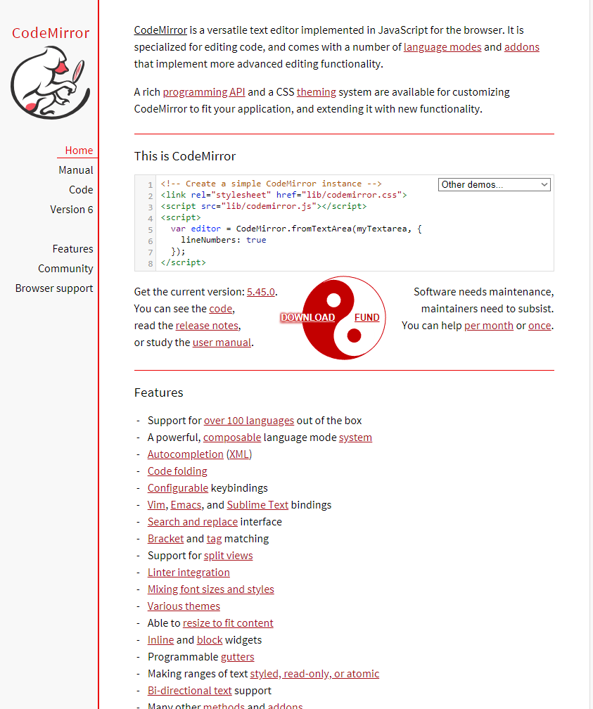
Editor Widget

Slide 13
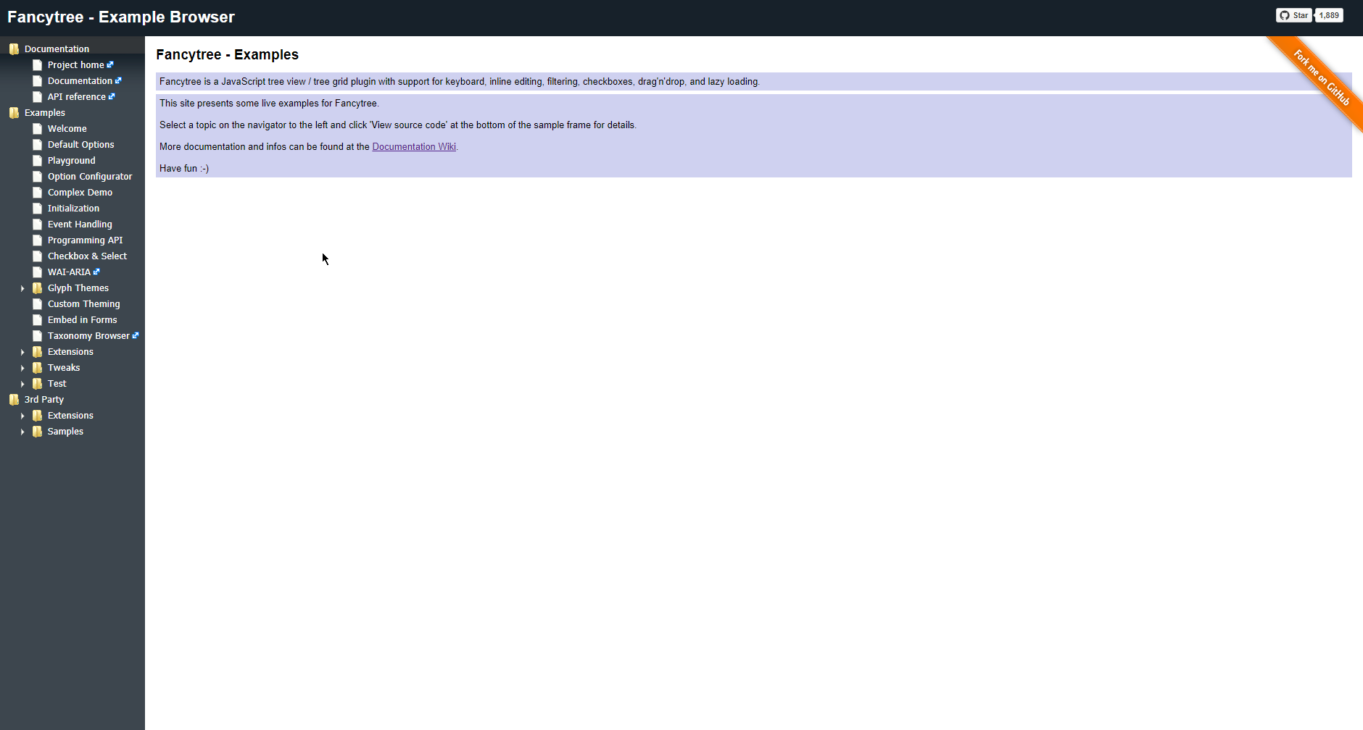
File Tree Widget

Slide 14
Web Page Widget

Slide 15


Slide 16
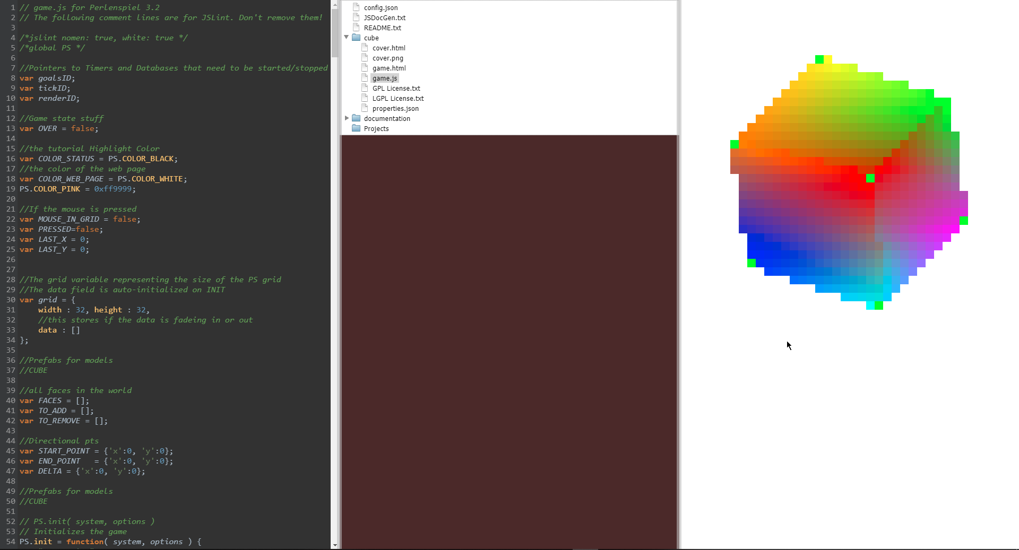

Slide 17
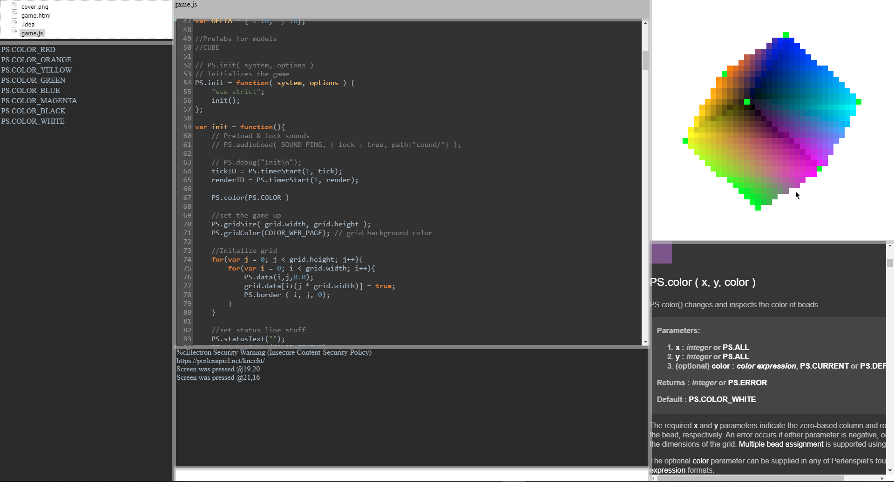

Slide 18
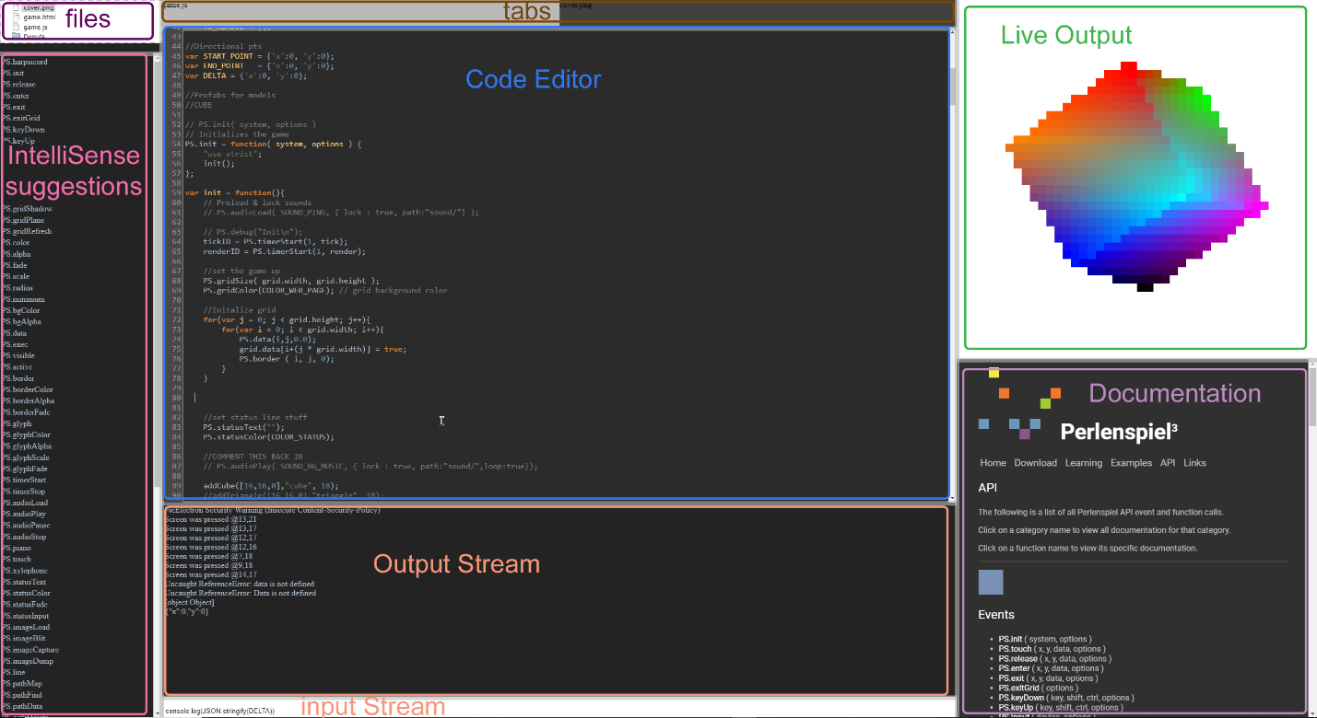

Slide 19

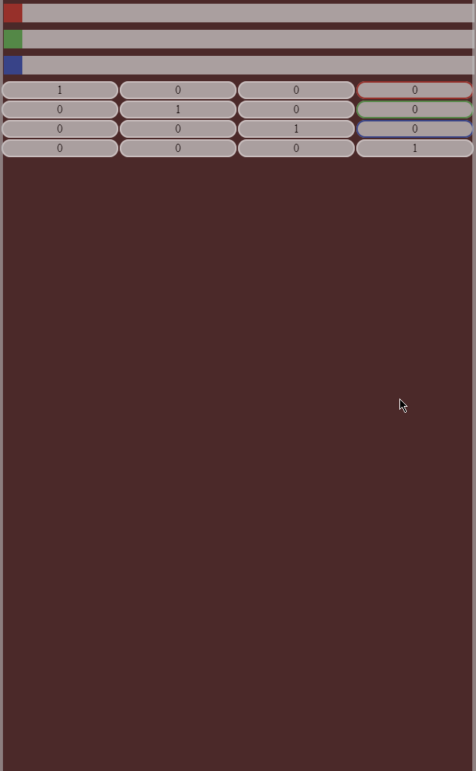


Slide 20

github.com/bhsostek/EGAD

Slide 21
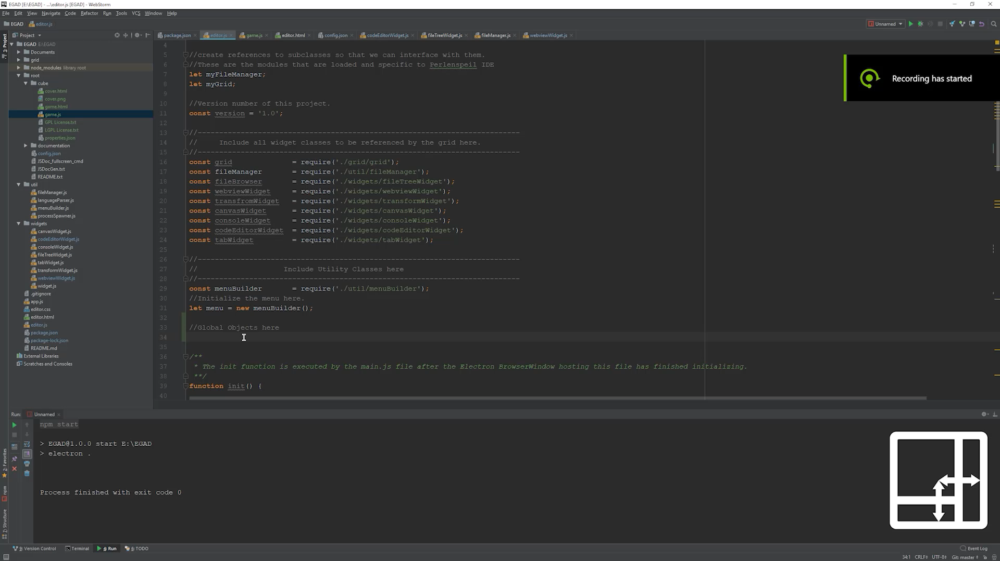

Slide 22
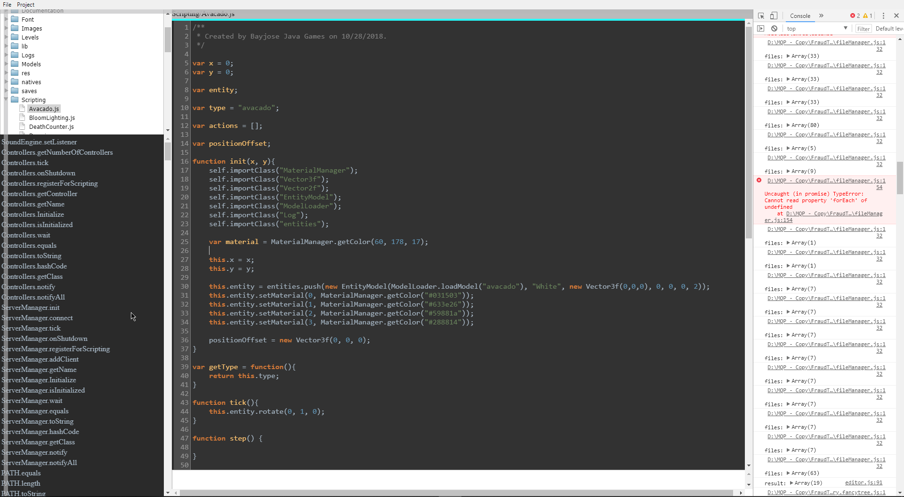
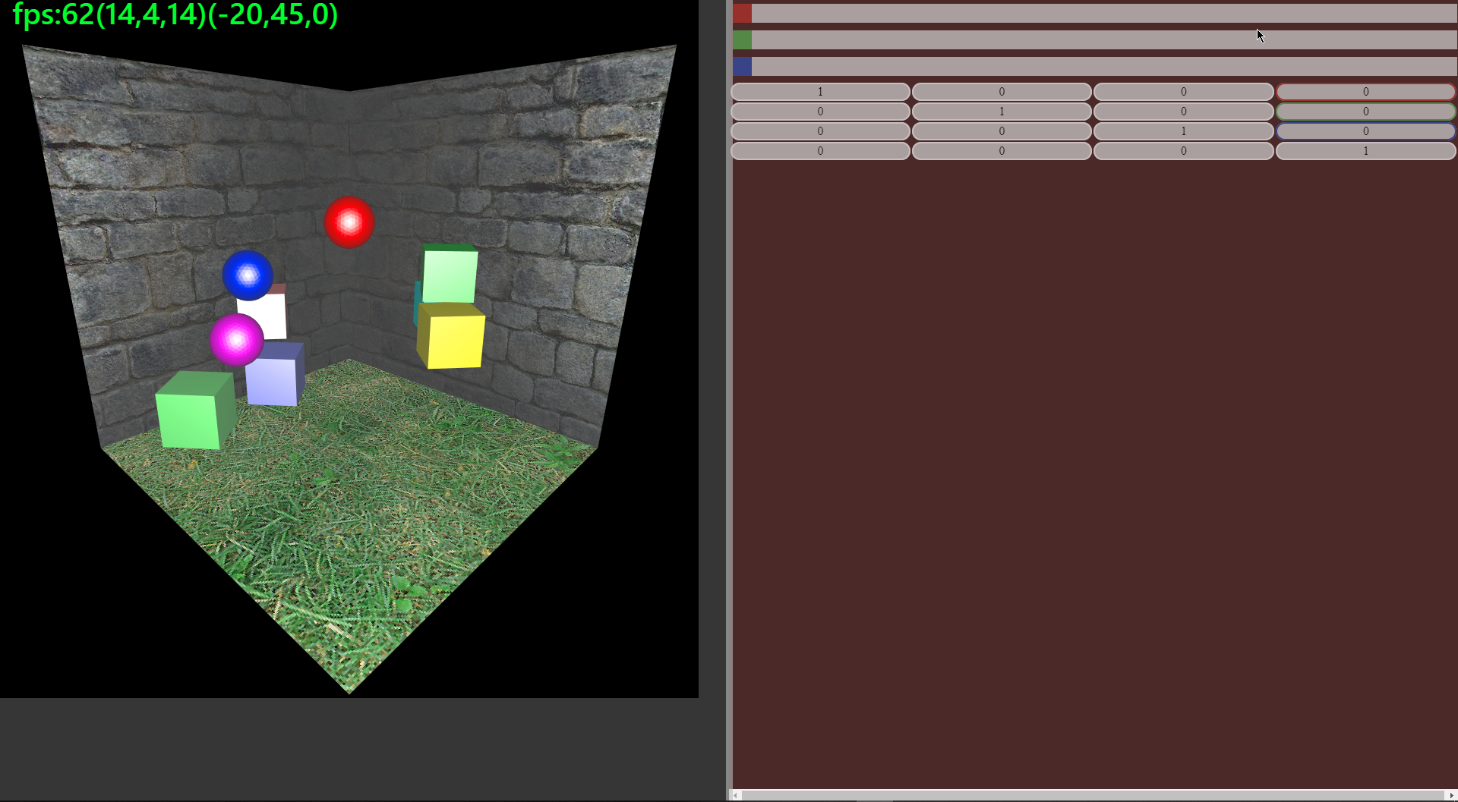

Slide 23
Thank You

